Slide 1
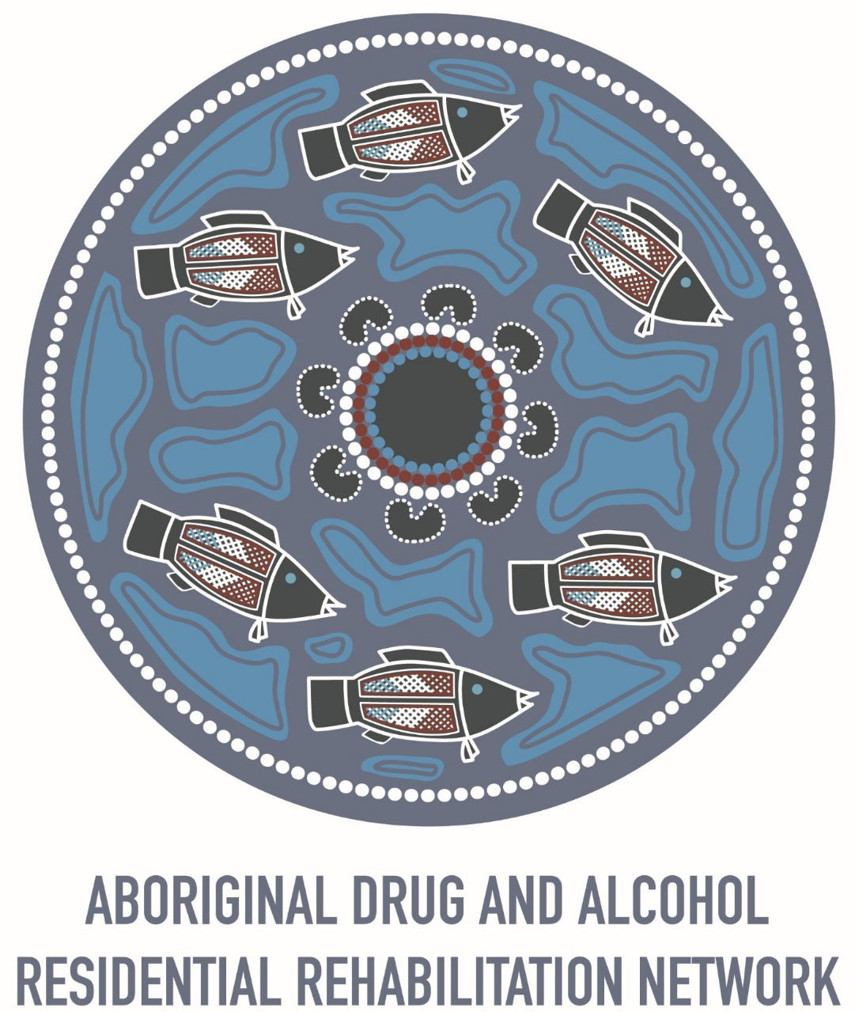

Slide 2
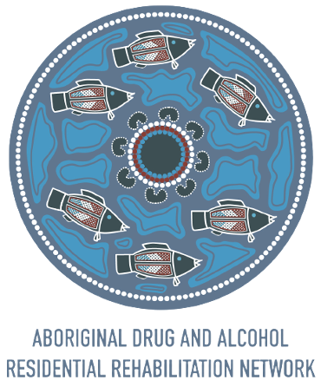
WHO IS ADARRN?
The Aboriginal Drug and Alcohol Residential Rehabilitation Network (ADARRN) is a network of Aboriginal Community Controlled residential rehabilitation services located throughout Australia that specifically address the needs of Aboriginal people requiring residential treatment interventions and healing for alcohol and other drug (AOD) and associated issues.
Notes:
https://www.adarrn.org.au

Slide 3
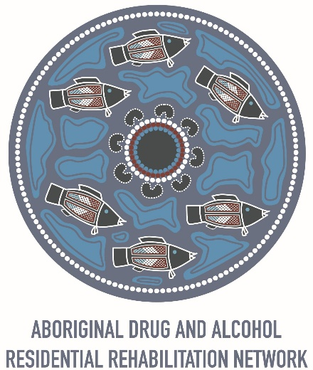
Colouring of the logo:
The blue represents the colours from the oceans and waterways from the coast and the coastal fish from the ocean and estuaries
The red represents the red for mother earth and inland Australia, and the muddy water fish
The centre of the logo represents a yarning circle where Aboriginal people have done business for tens of thousands of years- where no one is better than anyone else and everyone has the right to speak and be listened to
The fish represent the philosophy that a school of fish can survive and flourish better than an individual fish

Slide 4
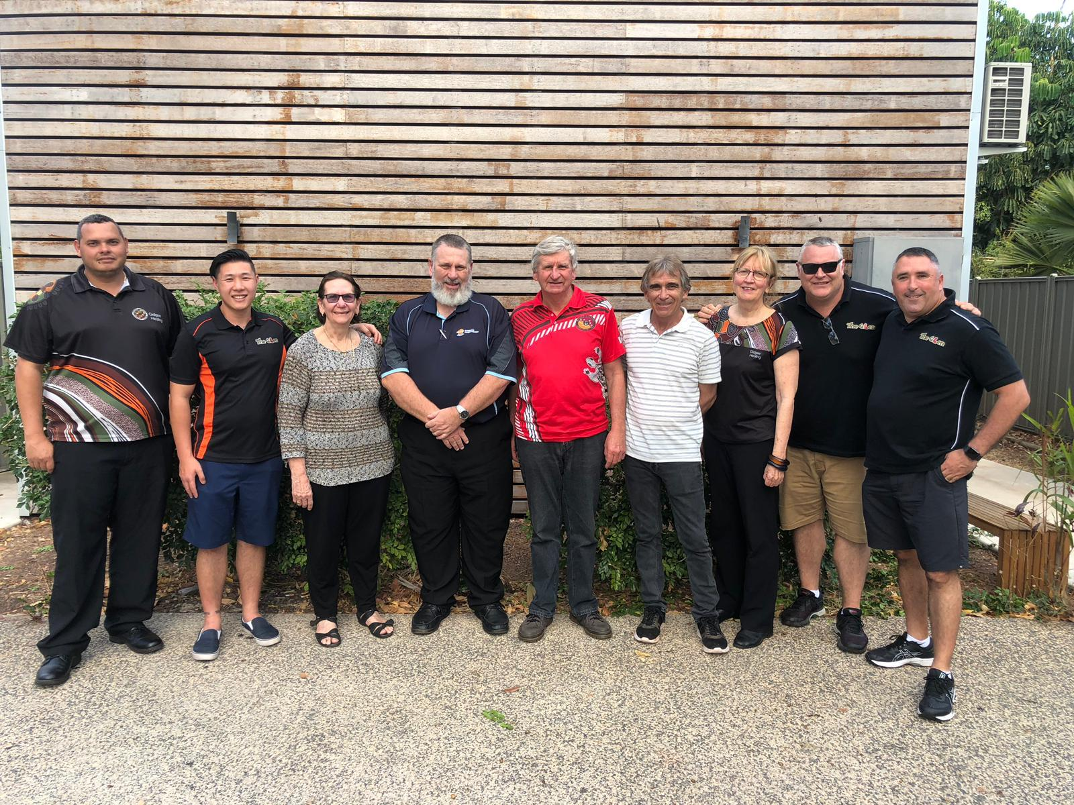
The Story So Far:
Current members:
The Glen - NSW
Weigelli - NSW
Orana Haven - NSW
Mayu Mali – NSW
Oolong House -NSW
FORWAARD – NT
CAAPU- NT
CAAPS- NT
Gumbi Gumbi – QLD
Gindaja - QLD
Aboriginal Drug & Alcohol Council- SA
Aboriginal Sobriety Group- SA

Slide 5
Model of Care summary
The ADARRN Model of Care demonstrates a community of practice entrenched in Aboriginal ways of working collectively to benefit all people
9 elements of the delivery model are woven together to be an interrelated and interdependent continuous process providing adaptability and quality improvement
The ADARRN Model of Care quadrants form a wholistic approach to empower clients throughout the recovery journey including connection to culture, personal development, substances and clinical interventions and long-term strategies to facilitate successful recovery.

Slide 6
How was the model developed?
This ADARRN Model of Care represents the culmination of several year’s work involving the member services, experts, clients (past and current) families and community.
Methods used in this development process include:
Direct consultations and workshops with services, clients and families;
Review of state and national strategies and relevant policy frameworks;
Detailed literature review; and
Assessment of current referral pathways and client cohort presentations.

Slide 7
Features of the Model of Care
What it includes
What it does not include
The overarching ADARRN Model of Care features 9 core elements which support the primary aim of our various services and programs: to support those experiencing harms related to the use of alcohol and other drugs and other associated harms
Culture is at the centre of healing, including cultural identity and culturally informed practice
Culturally aware and culturally appropriate service delivery
Holistic, strength-based, trauma-informed approaches
Person-centred approaches within a family and community framework
Flexible therapeutic options and healing opportunities
Evidence-based approaches
Skilled and diverse workforce
Partnerships and collaborative service networks
Evaluation and continuous improvements
The Model of Care specifically does not detail a range of aspects related to the treatment and healing approaches offered by ADARRN member services:
Specifically, this cannot be used to inform the following:
Internal program elements for individual services
Specific details regarding cultural practices or healing modalities
A definitive listing of healing and treatment options
Prescriptive steps or developmental approaches
Tailored programs for discrete client cohorts
Individualised healing and cultural reconnection methods

Slide 8
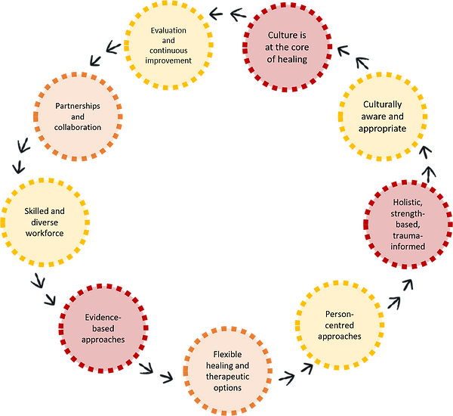
Model of Care 1.0

Slide 9
Model of Care 2.0

Slide 10
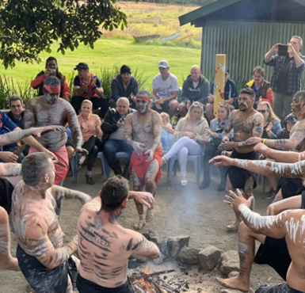
1. Culture at the core of healing
Healing is a complex mix of spiritual, emotional and physical elements
Importance of cultural connection and identity
Individual healing plans and focus on trauma-informed care and healing approaches

Slide 11
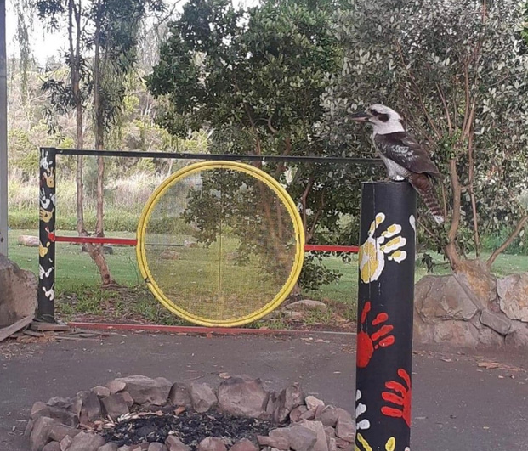
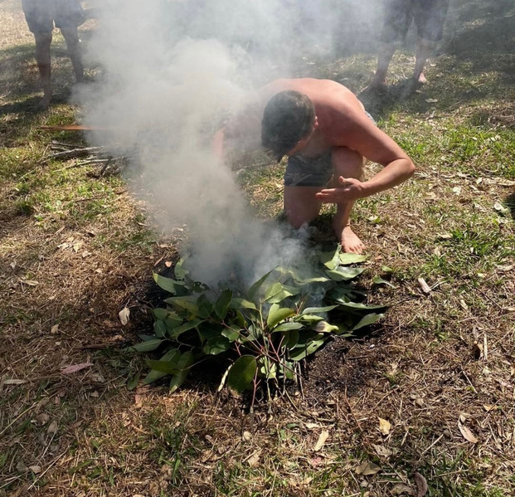
2. Culturally aware and culturally appropriate service delivery
Family and Kinship ties
Communities are often complex blend of cultural and historical ties
Respect for differing approaches to Men's and Women's business

Slide 12
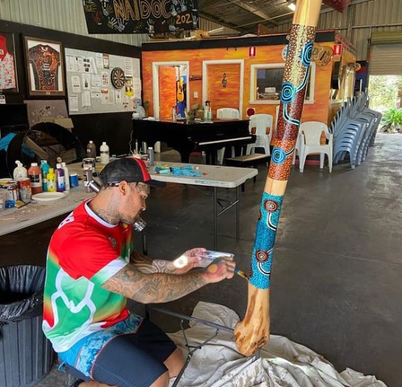
3. Holistic, strength-based, healing –informed & trauma aware approaches
Holistic
Mental, Physical, Environmental, Social and Spiritual dimensions to life
Resilience and strength-based approaches
Promote self-reliance, participation, collaboration and control and recognise the underlying social determinants of health

Slide 13
4. Person-centred approaches within a family and community framework
Healing is complex
Flexible harm minimisation approaches are the most appropriate
The client's cultural and individuals needs, preferences, beliefs and values need to be taken into account, as well as their comfort and surroundings
Journey of healing, a reconnection with oneself

Slide 14
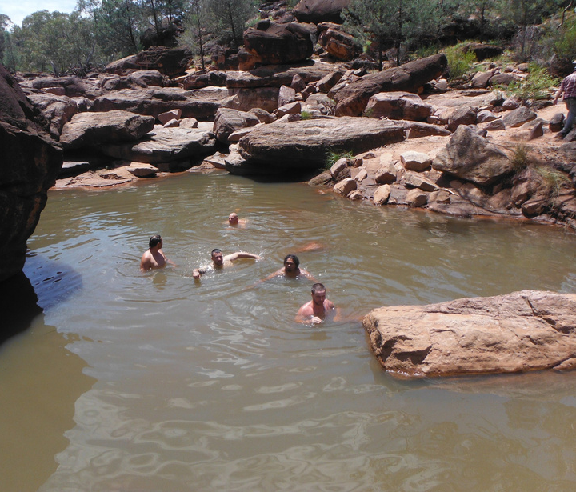
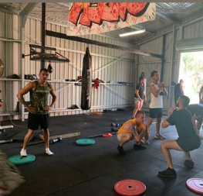
5. Flexible therapeutic options and healing opportunities
Diverse range of options
No single over-arching treatment or healing philosophy
Meet the needs of diverse local and state-wide communities by providing a continuum of service approaches and options

Slide 15
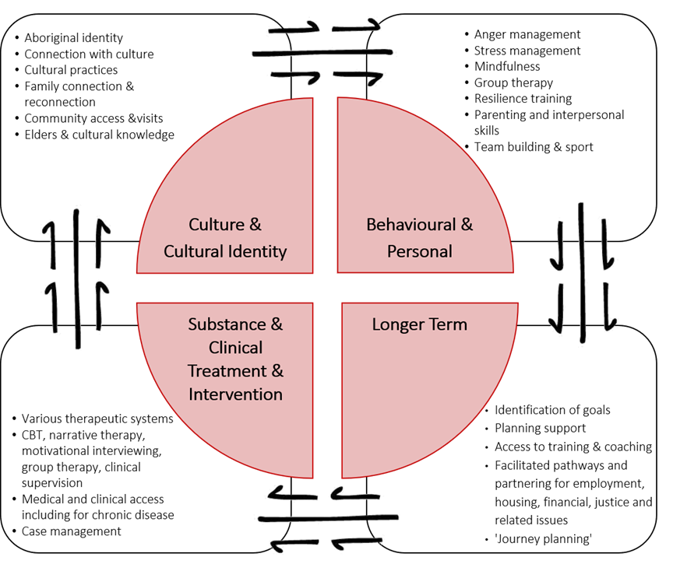
6. Evidence Based Approaches
Comprehensive assessment, case management and review process
These options include but are not limited to:
cultural practices,
dance,
exercise,
CBT,
mindfulness,
narrative therapy,
motivational interviewing, resilience training,
anger/stress management,
facilitated pathways for employment,
housing,
Financial,
justice related issues
All in which are created or adapted with and for Aboriginal people

Slide 16
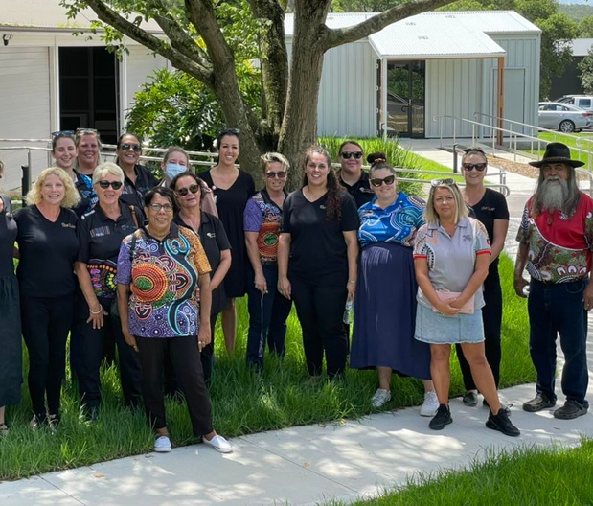
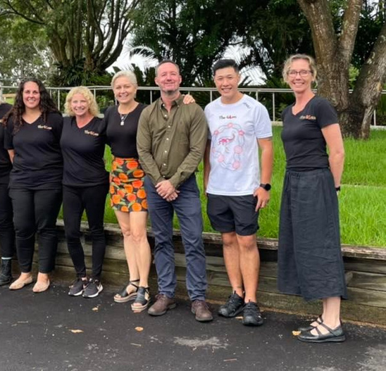
7. Skilled, diverse & supported workforce
Collection of experience, skills, connections and qualifications
Staff and managers with high level qualifications across a range of disciplines, sector-specific AOD qualifications and many other associated capacities such as counselling, mediation, coaching, life skills, planning, employment, training and relationships
Combinations of lived experiences, knowledge, skills and training ensure that services are flexible, innovative and resilient in their work with clients
Staff being culturally connected and knowledgeable, operating in a non-judgmental capacity and being caring, compassionate and respectful

Slide 17
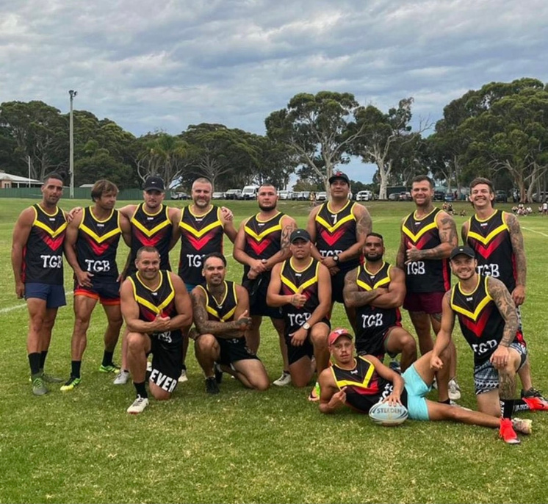
8. Partnerships and collaborative service networks
ADARRN members focus on ensuring their services are well integrated with other multi-sectoral services
Other organisations/partnerships such as:
Health
Justice
DCJ
TAFE
Centrelink
Relationships Australia
AH&MRC
NADA
Local sporting groups
Job provider networks

Slide 18
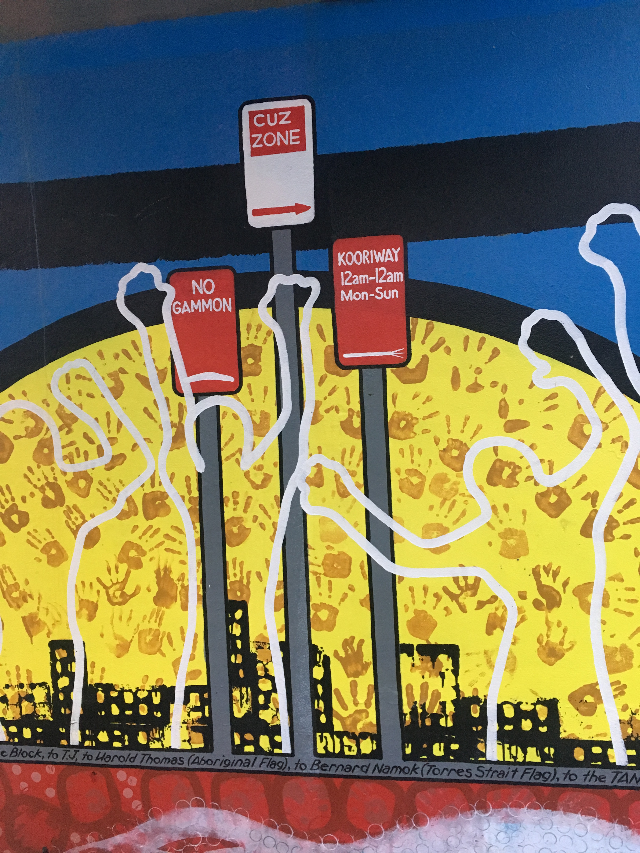
9. Evaluation and continuous improvement
Rigorous evaluation criteria and reporting conditions for disparate funding providers, research collaborations and client case management
CQI strategies may include:
Client surveys
Accreditation reviews
Suggestion box
Committees
Regular staff training/meetings

Slide 19
How to contact ADARRN
Website:
https://www.adarrn.org.au/
Social Media:
Adarrn__
Aboriginal Drug and Alcohol Residential Rehabilitation Network - Adarrn

